Slide 1
Data Commons Project:
Ownership diversity and Business diversity in Fairfax

Slide 2
Goal and Data
The goal is to characterize (in Fairfax county):
Business ownership diversity: The diversity of business owner as being part of a minority.
Business diversity: The diversity of business activity in terms of industries.
Data
Mergent Intellect (available through UVA).
The data reports information on companies such as company name, minority owned, primary industry (naics at 5 digits), company type (public/private), employment over time.
Minority owned definition (from Mergent Intellect) :
A U.S. business that is at least 51% owned by, and whose management and daily business operations are controlled by, one or more members of a socially and economically disadvantaged minority group, namely U.S. citizens who are African Americans (Black), Hispanic Americans, Native Americans, Asian-Pacific Americans and Sub-Continent Asian Americans. Available for US businesses.

Slide 3
Data treatment and Methodology
Data treatment
Reformate the address and geolocated each company using GoogleMap api. Based on the geolocation we assign each company to a census block
Small business definition:
Company with an employment at the location and a year less than 50.
We break small business into solo proprietor (only one employee) or not.
Regroup company by industry (NAICS 2 digits).
Methodology:
Describes the business activity profile in terms of ownership diversity and industry diversity in Fairfax.
Concentration of business (owned by minority or not) in some industries or locations
Zoom on specific area: Tyson, Franconia, Springfield

Slide 4
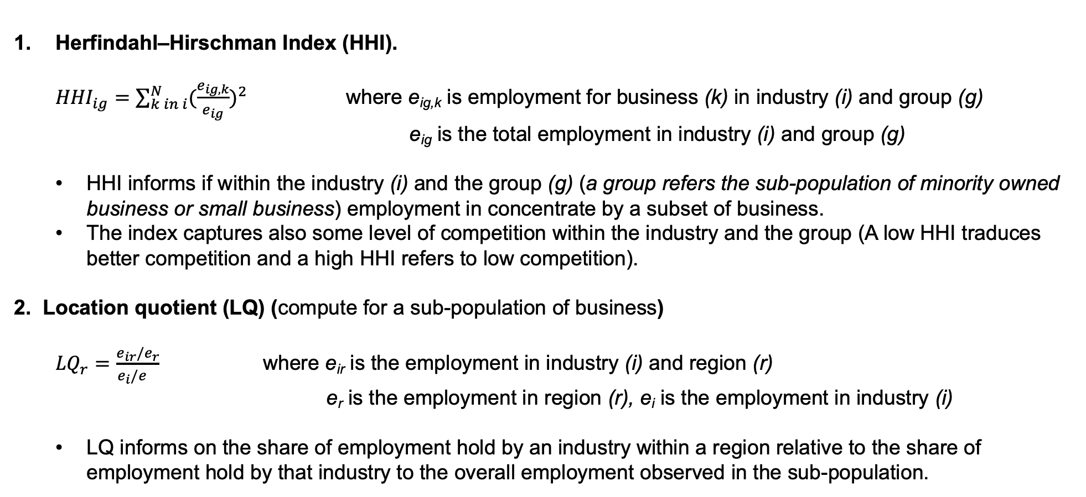
Key metrics
Herfindahl–Hirschman Index (HHI).
${HHI}_{ig}=\sum_{k in i}^{N}{{(\frac{e_{ig,k}}{e_{ig}})}^{2}}$ where e_{ig,k} is employment for business (k) in industry (i) and group (g)
e_{ig} is the total employment in industry (i) and group (g)
HHI informs if within the industry (i) and the group (g) (a group refers the sub-population of minority owned business or small business) employment in concentrate by a subset of business.
The index captures also some level of competition within the industry and the group (A low HHI traduces better competition and a high HHI refers to low competition).
2. Location quotient (LQ) (compute for a sub-population of business)
${LQ}_{r}=\frac{e_{ir}/e_{r}}{e_{i}/e_{}}$ where e_{ir} is the employment in industry (i) and region (r)
e_{r} is the employment in region (r), e_{i} is the employment in industry (i)
LQ informs on the share of employment hold by an industry within a region relative to the share of employment hold by that industry to the overall employment observed in the sub-population.

Slide 5
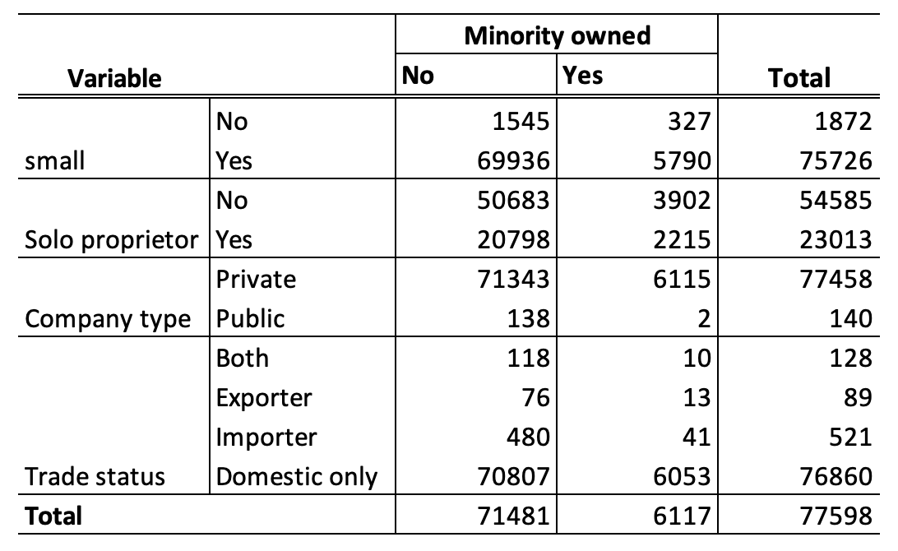
Fairfax county profile: All business between 2010-2020
97.25 % of business in Fairfax are smaller
30.38 % of small business in Fairfax (75726) are solo proprietor
Few minority business are involved in international trade
7 % of business in Fairfax were owned by minority. 94.65 were small business and 36.21% were solo proprietor.

Slide 6
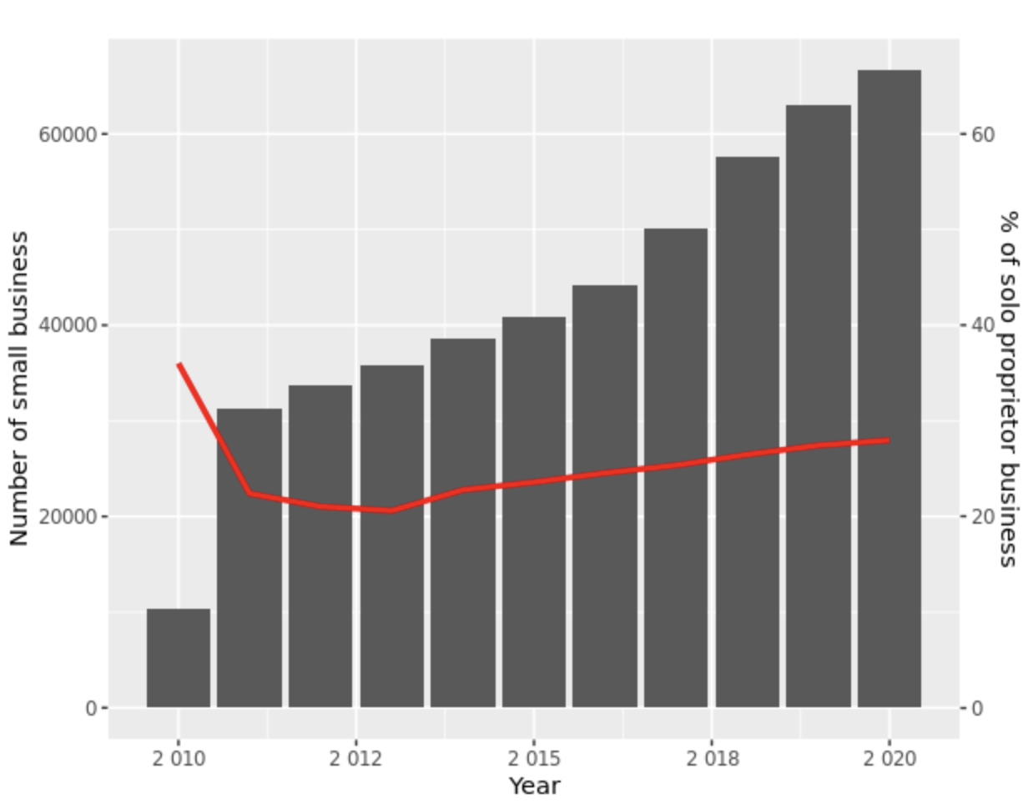
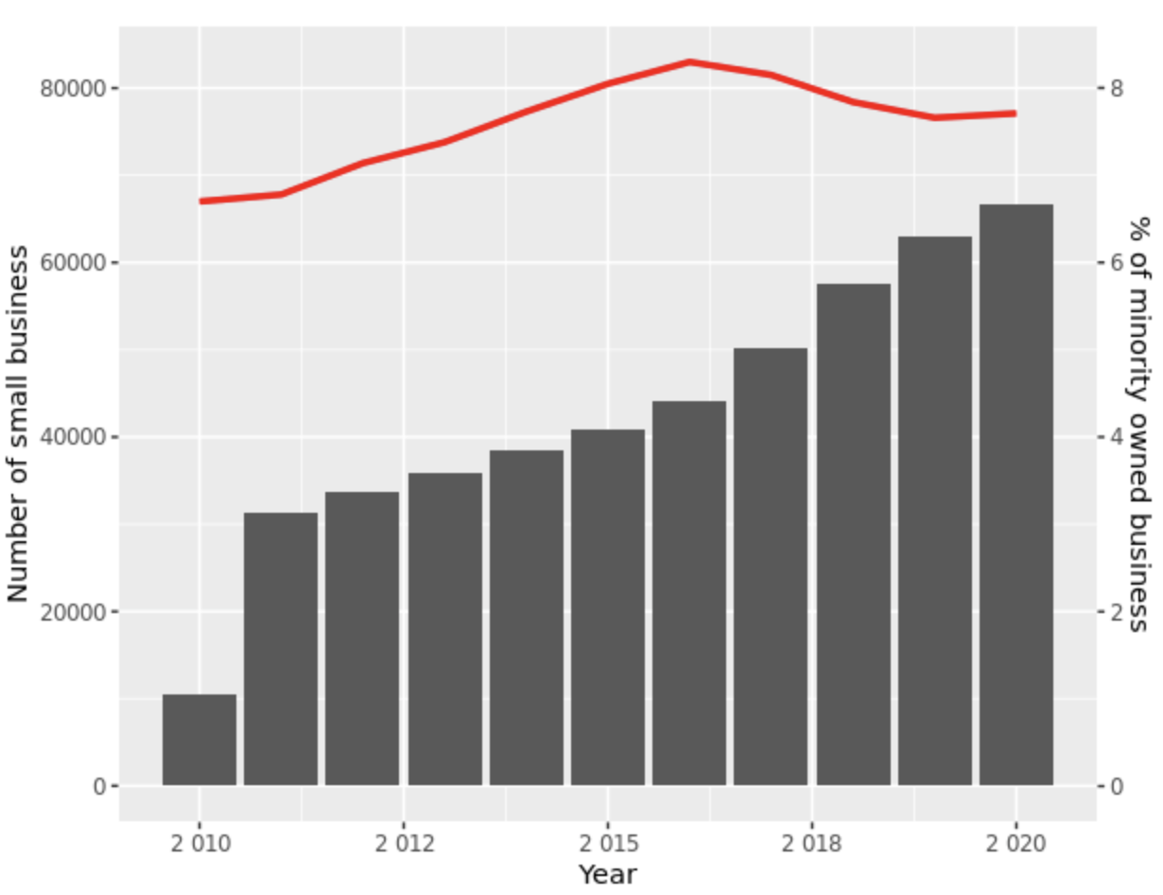
Fairfax county profile: All business between 2010-2020

Slide 7
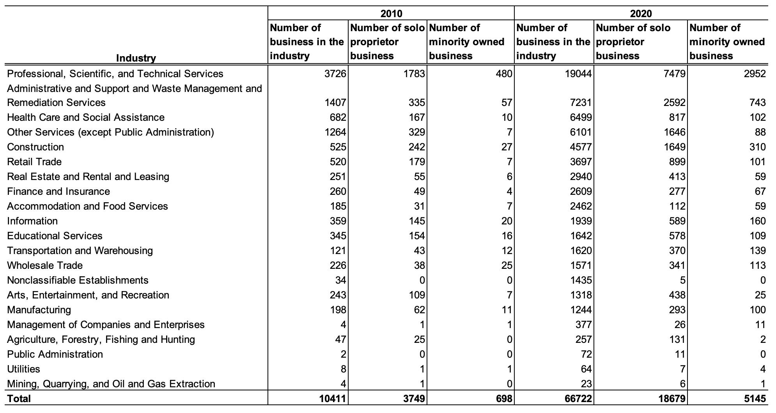
Fairfax county: distribution of small business by industry

Slide 8
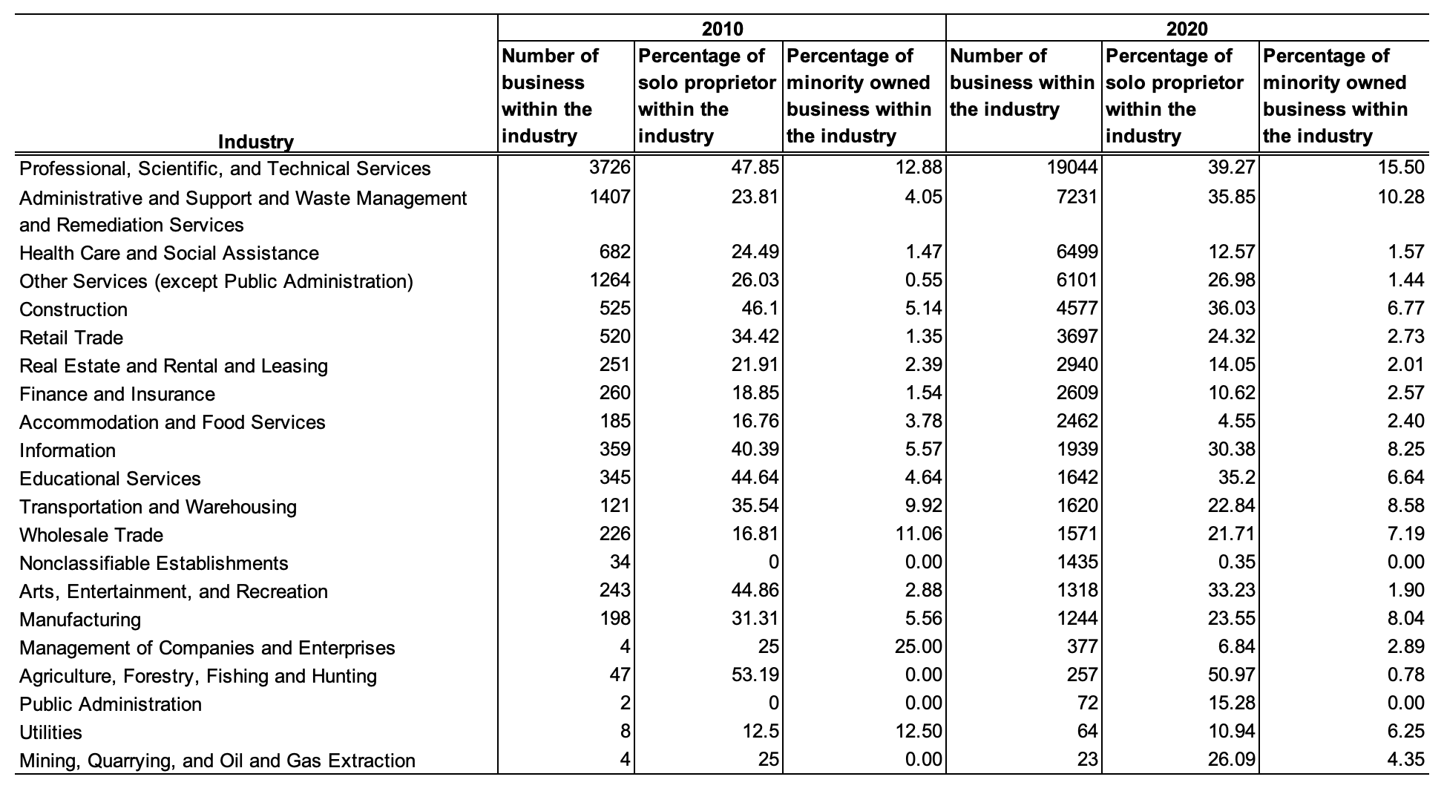
Fairfax county: within industry profile of small business

Slide 9
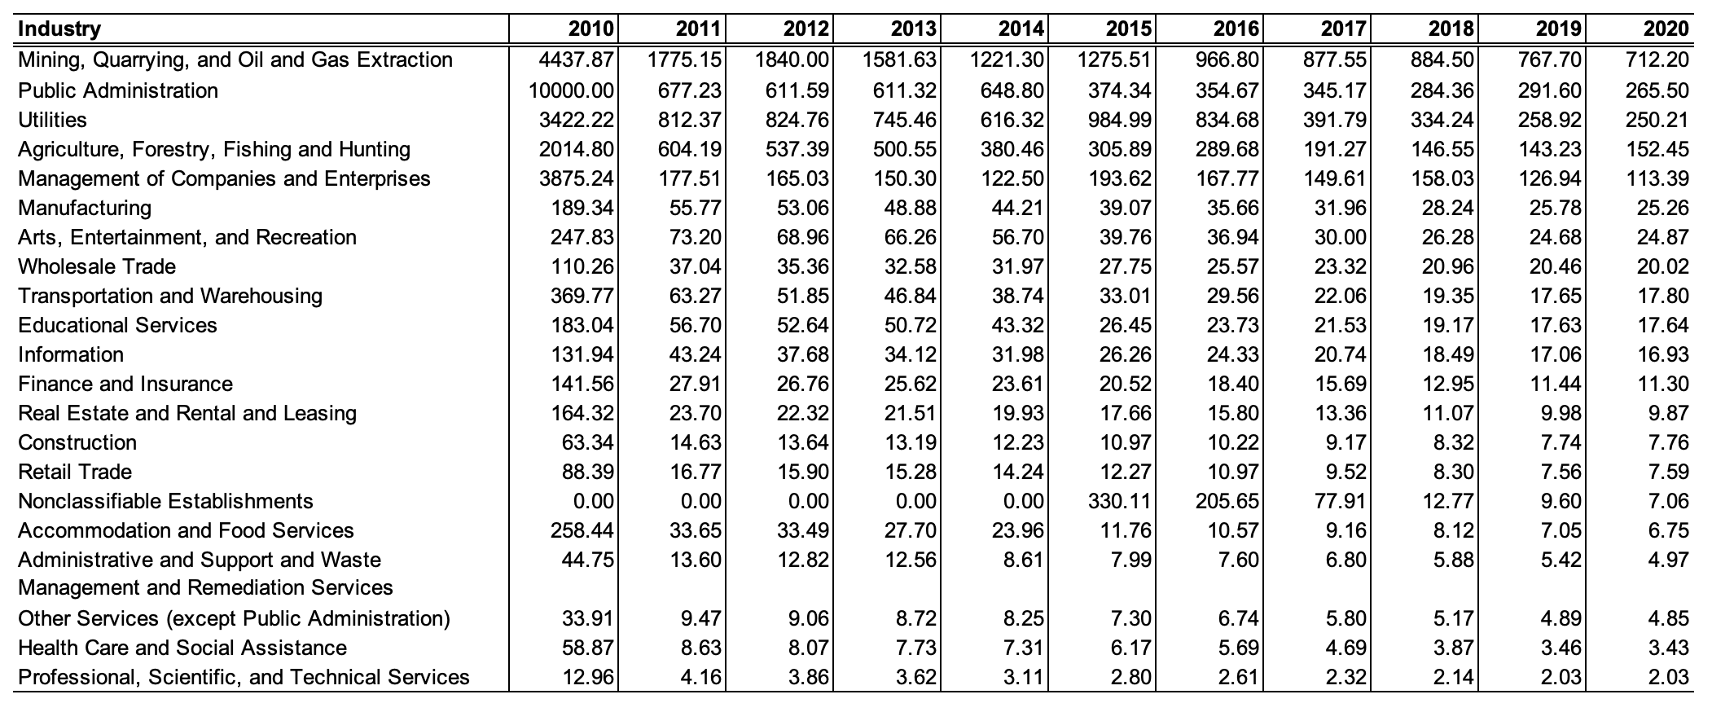
Fairfax county: small business industry concentration (HHI)
Which industry concentrate the small business employment?
less
Competition between small business in 2020
more

Slide 10
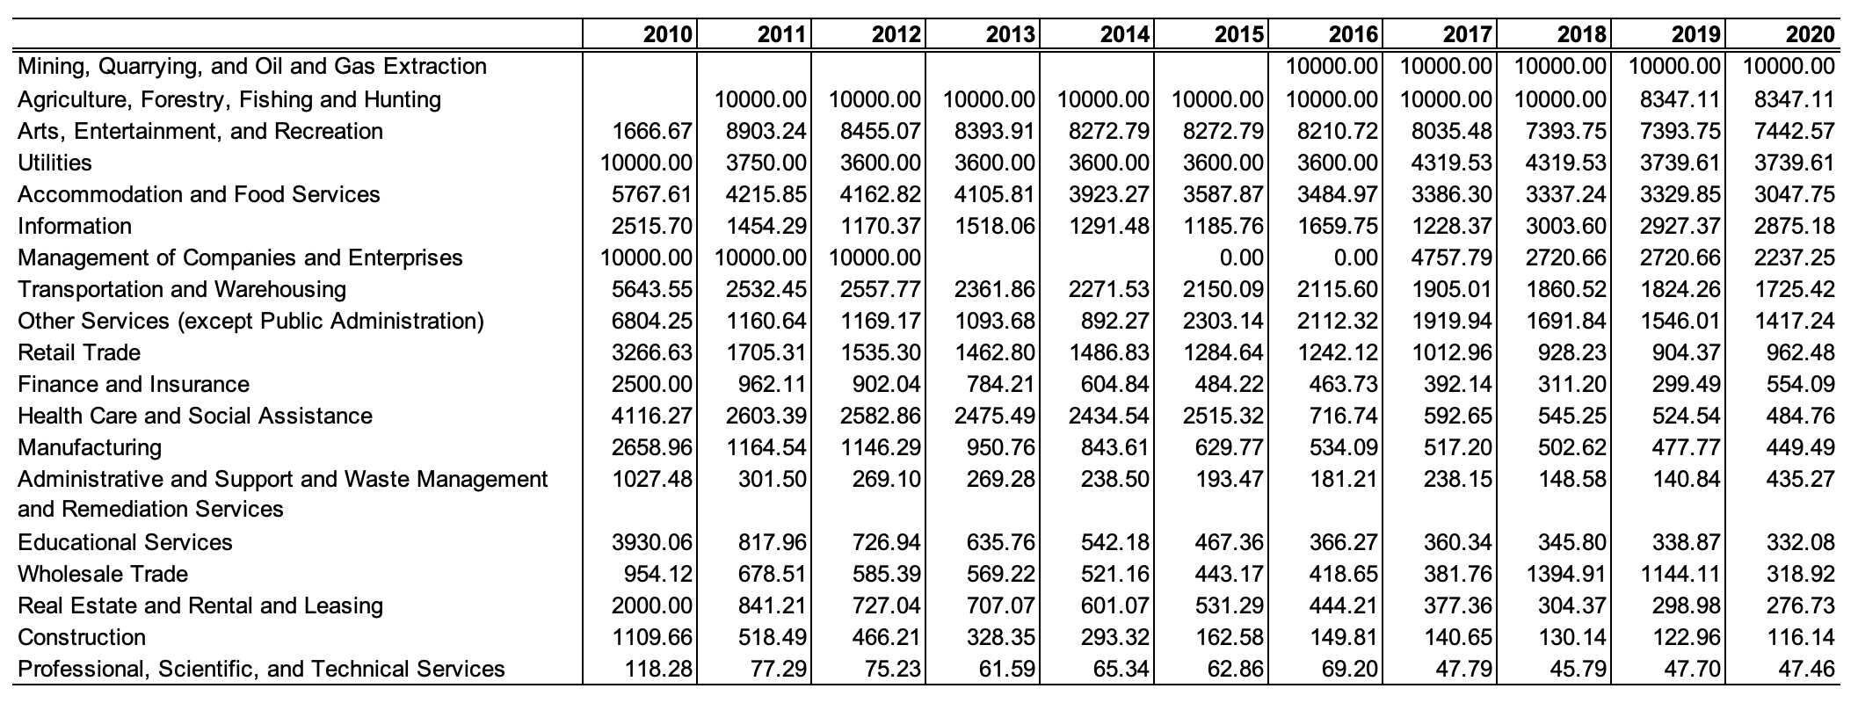
Fairfax county: minority business industry concentration (HHI)
Which industry concentrate the employment of small business hold by minority?
less
Competition between minority owned business in 2020
more

Slide 11
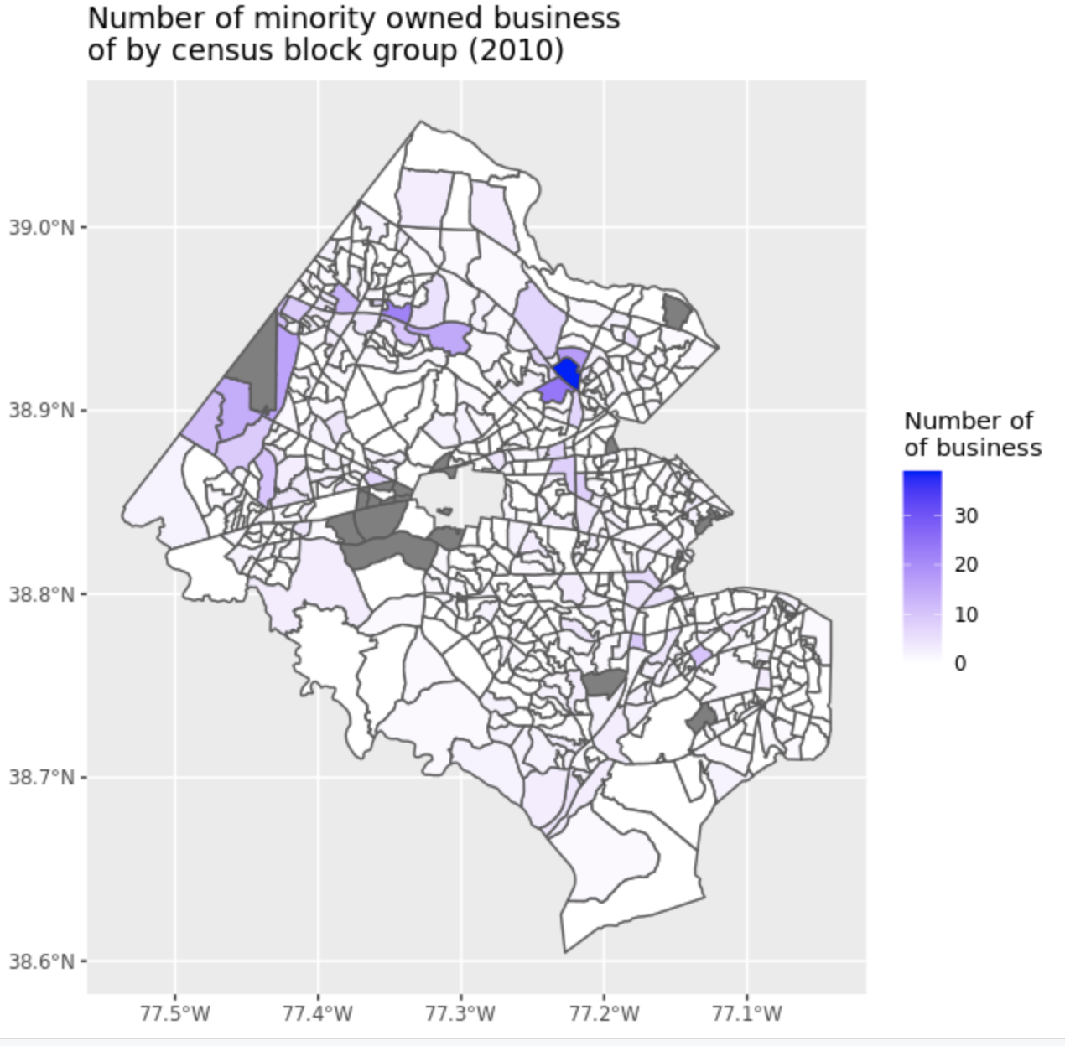
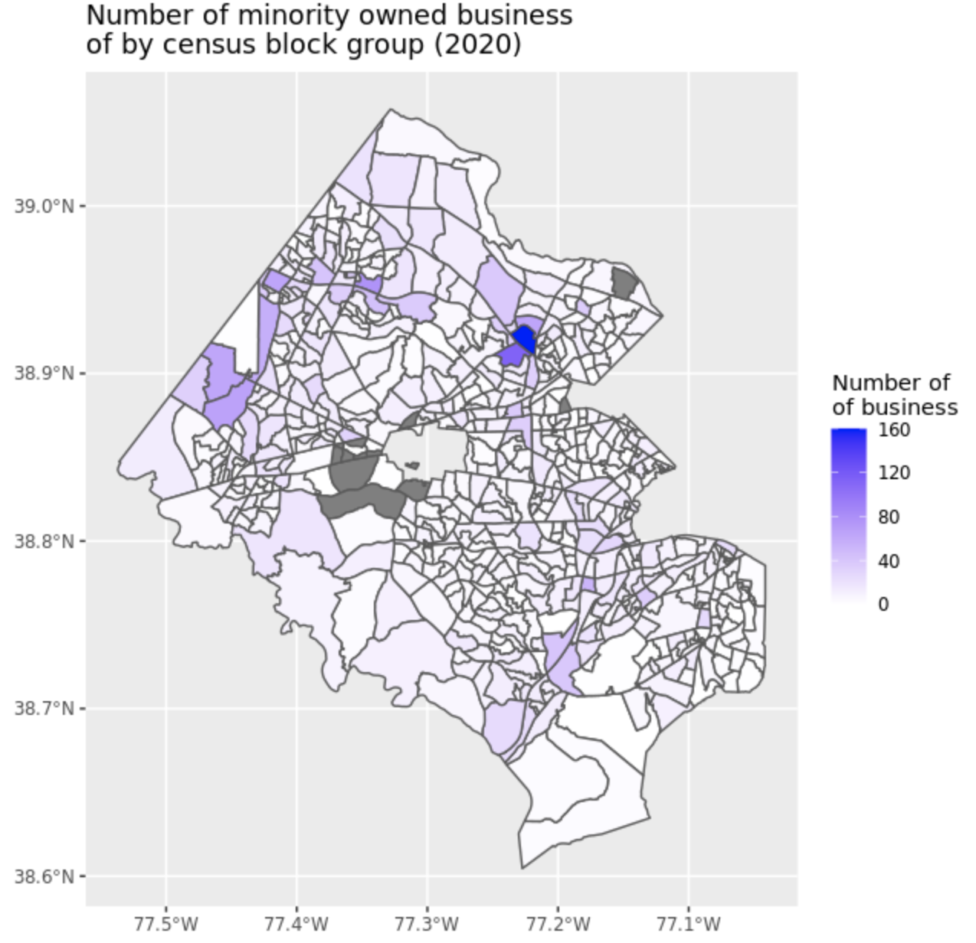
Fairfax county: minority owned business geo distribution

Slide 12
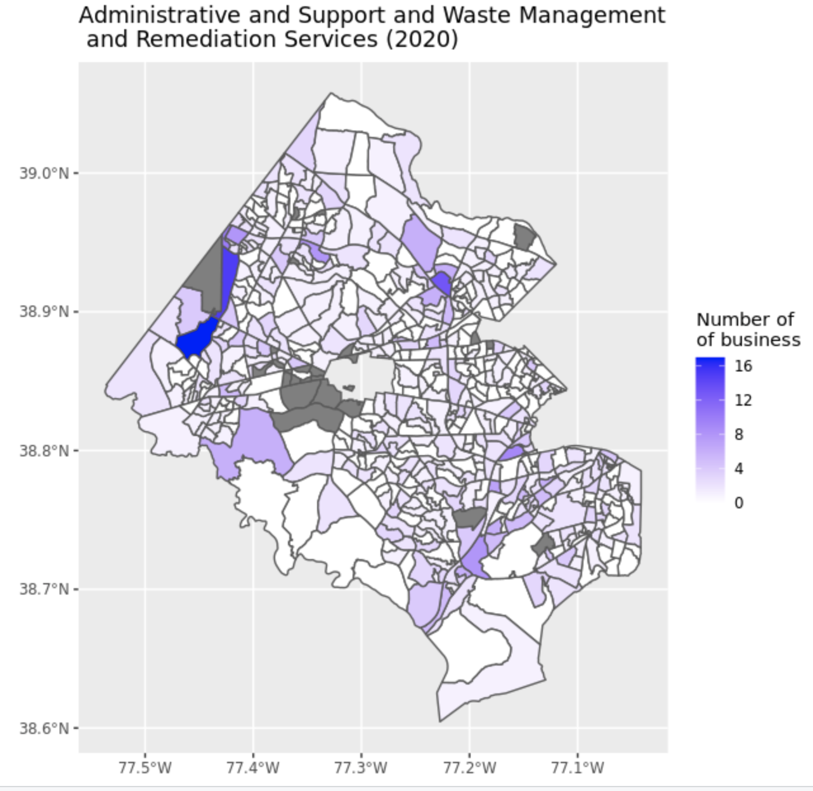
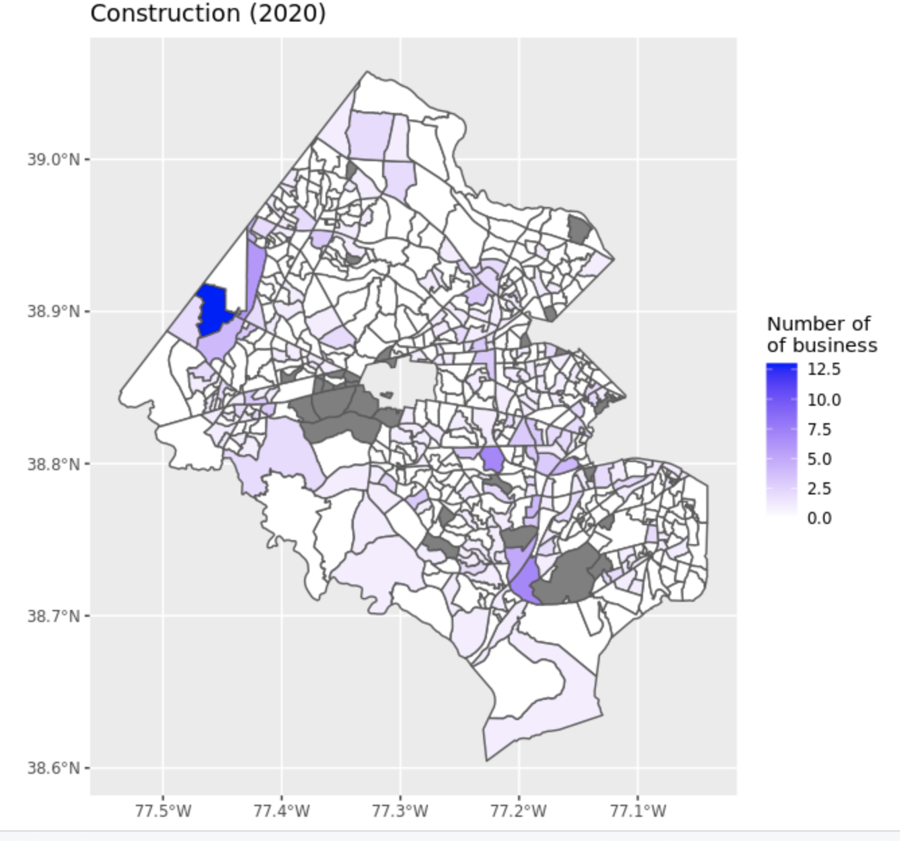
Fairfax county: minority owned business density by industry

Slide 13
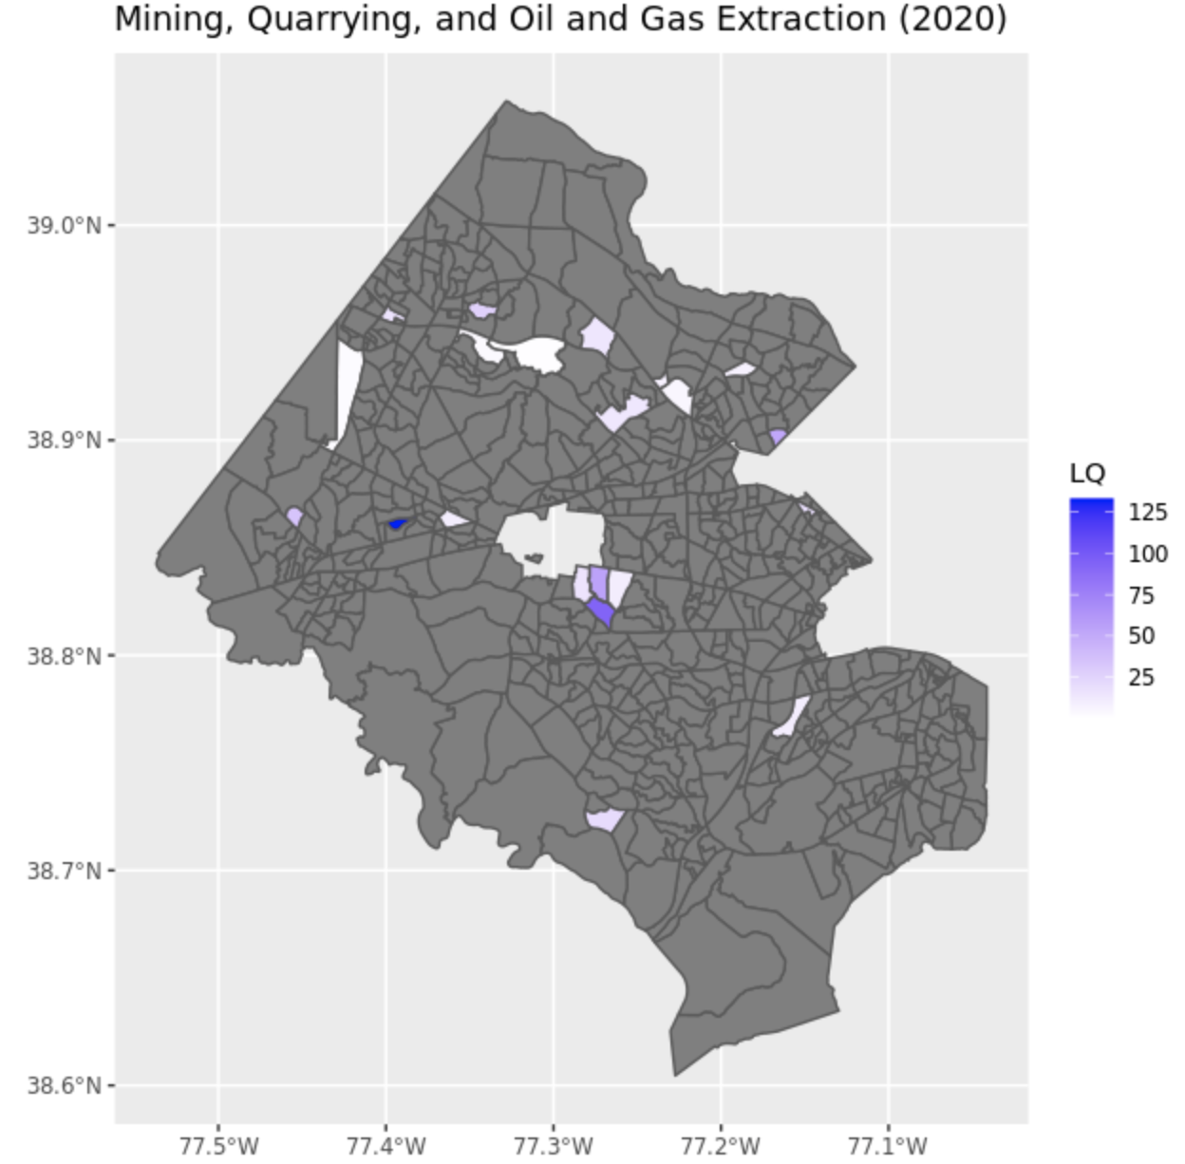
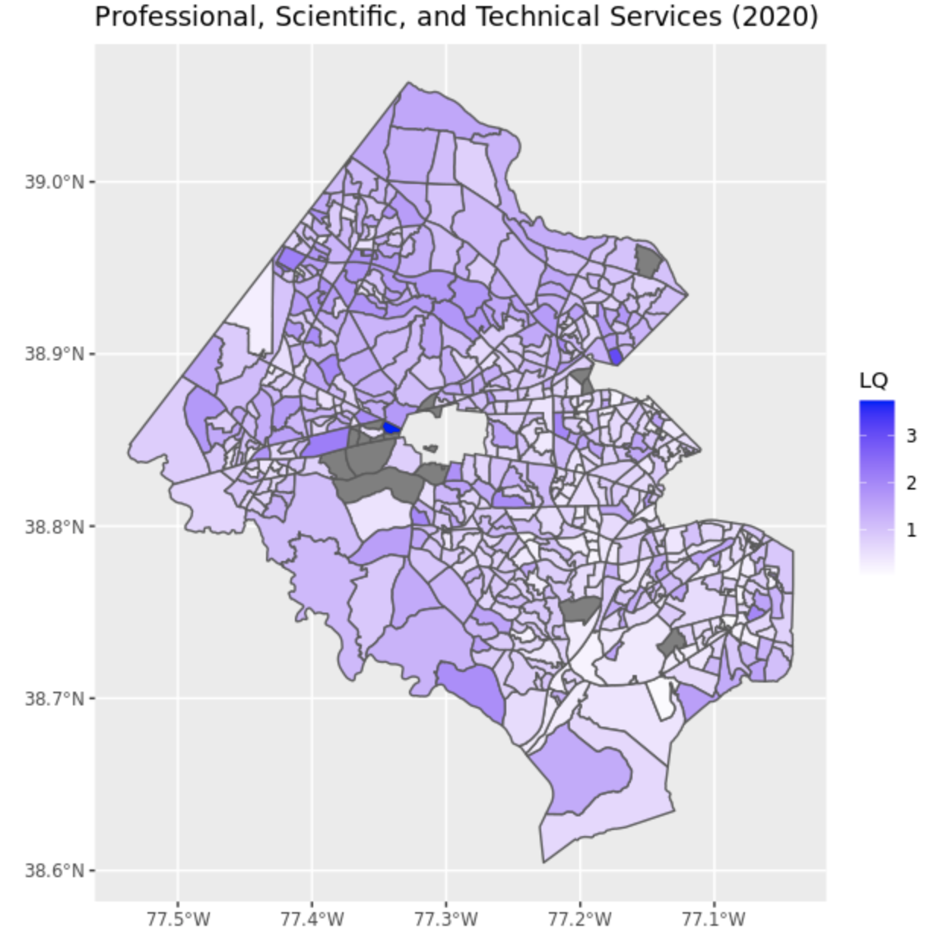
Fairfax county: LQ in industry with an employment concentration for small business
High HHI index
Low HHI index

Slide 14
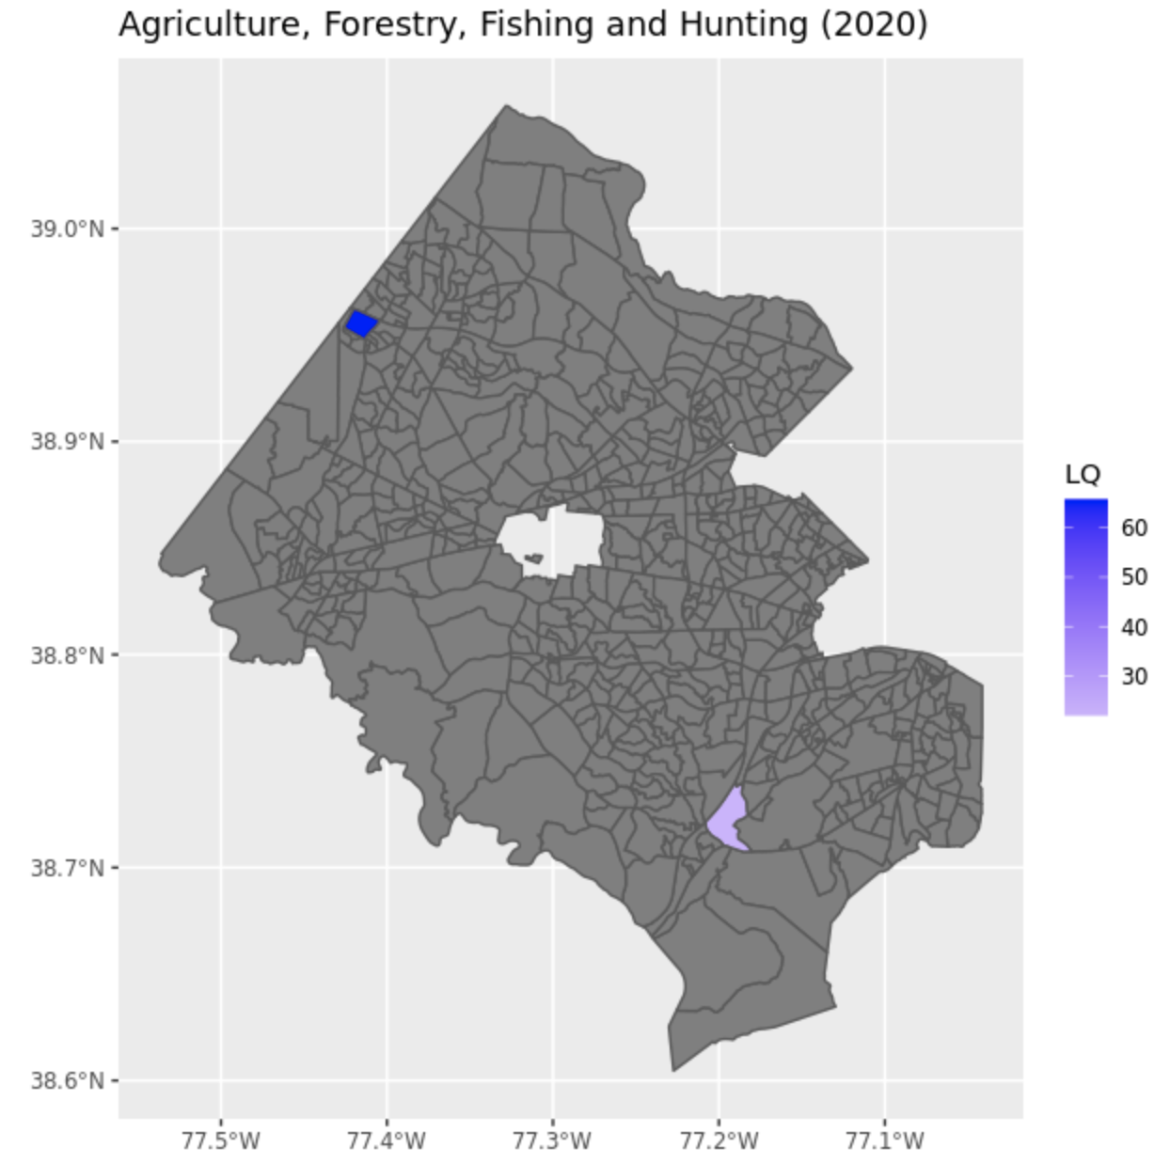
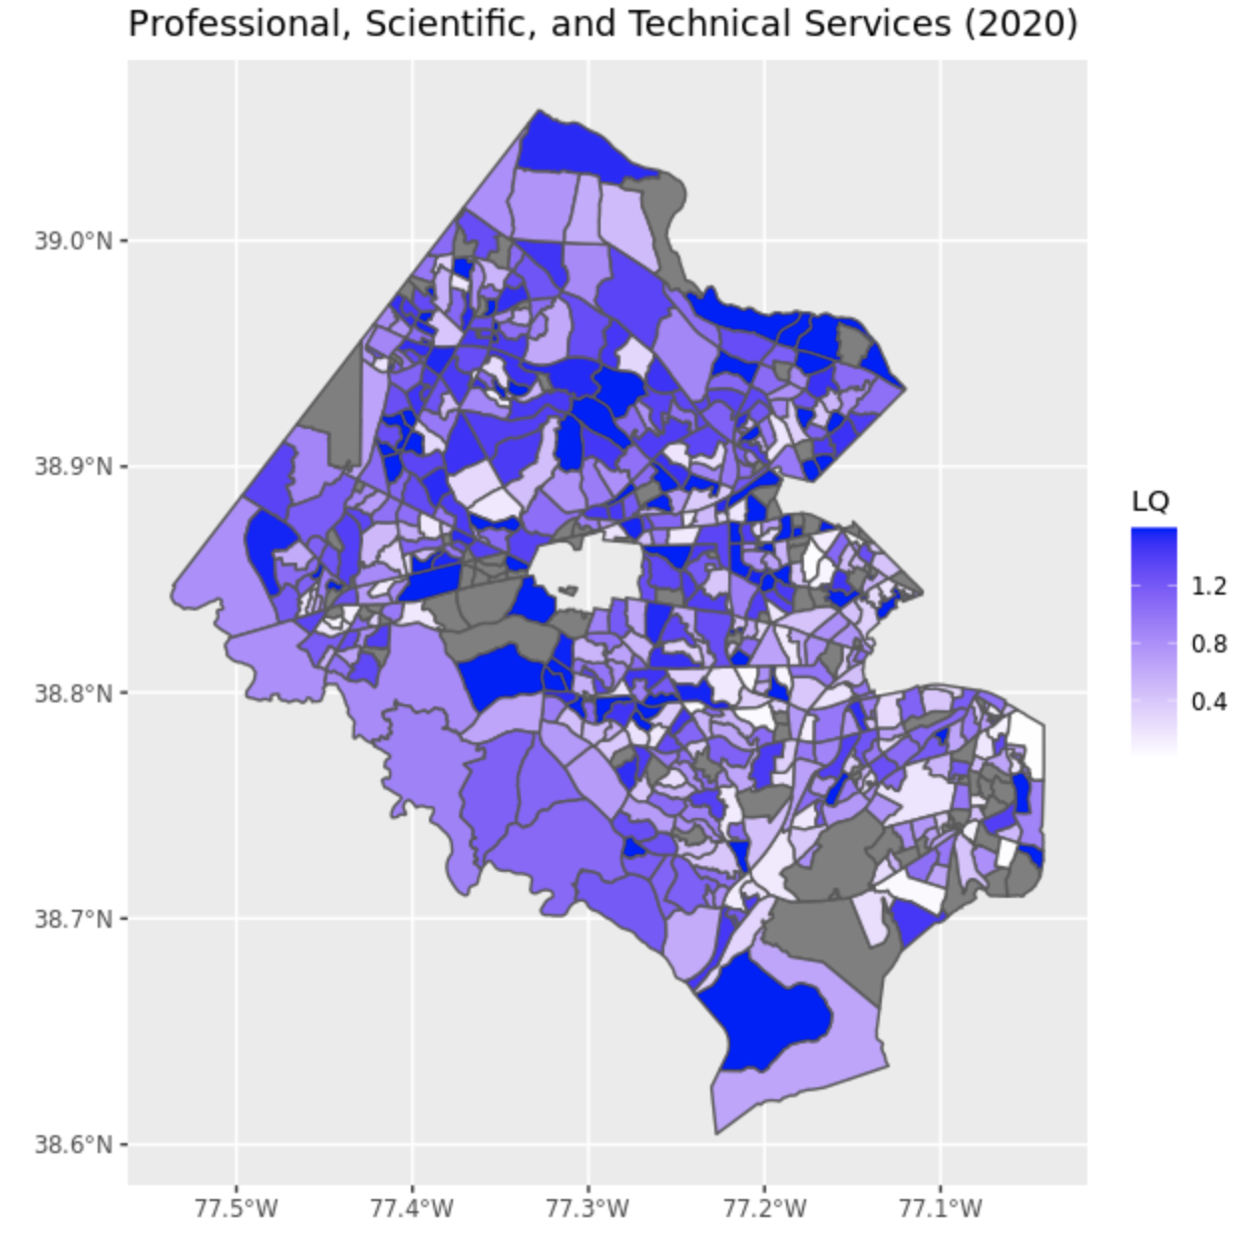
Fairfax county: LQ in industry with an employment concentration for small business owned by minority
High HHI index
Low HHI index

Slide 15
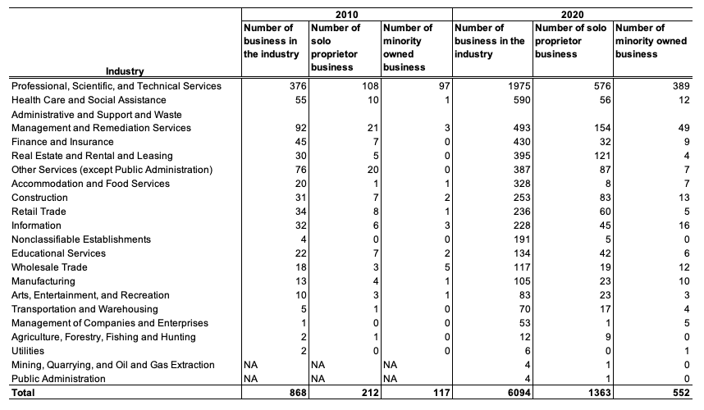
Zoom within Tysons: business profile (small and minority owned)

Slide 16
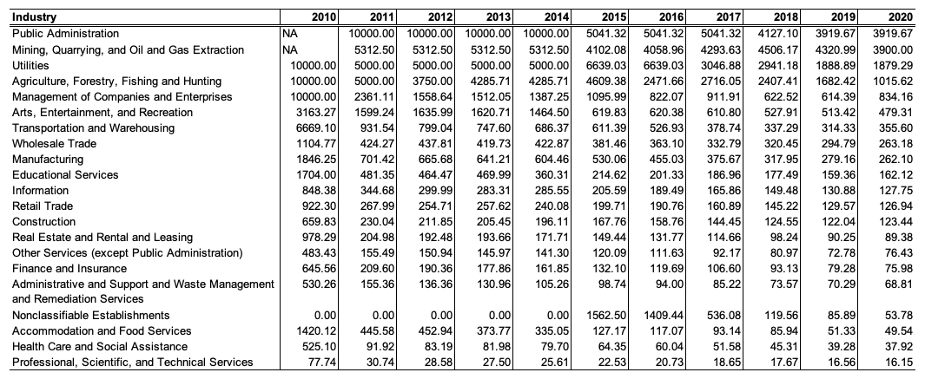
Zoom within Tysons: small business HHI index

Slide 17
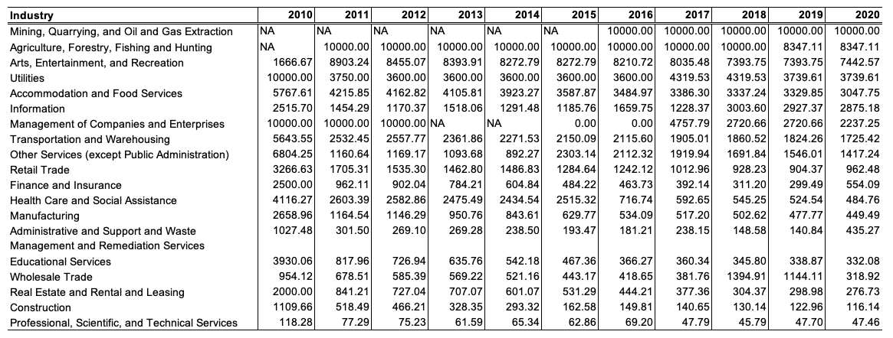
Zoom within Tysons: minority owned business HHI index

Slide 18
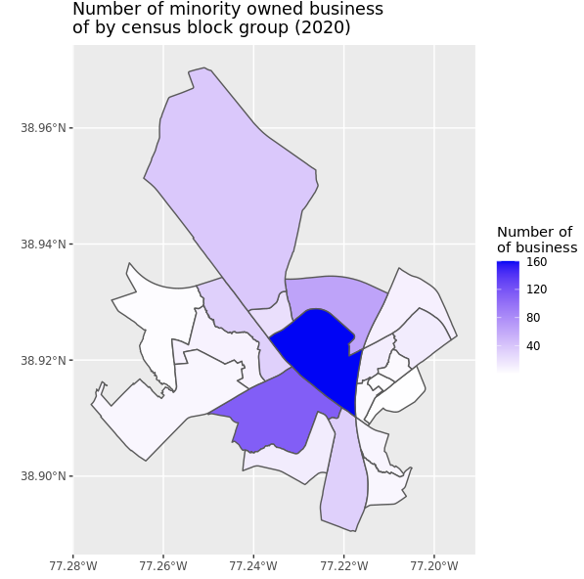
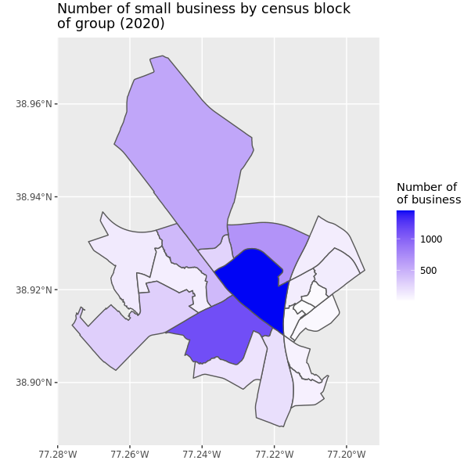
Zoom on Tysons : business profile (small and minority owned)

Slide 19
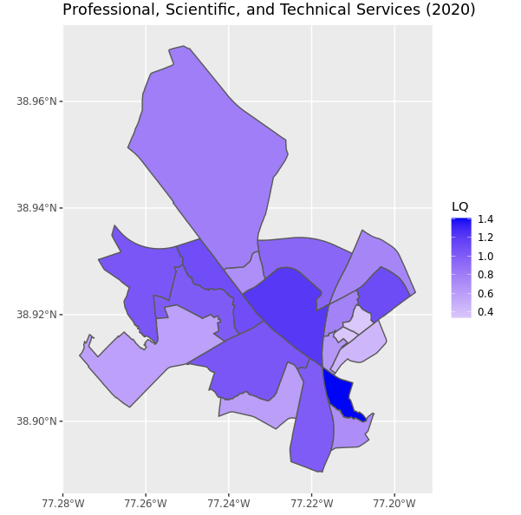
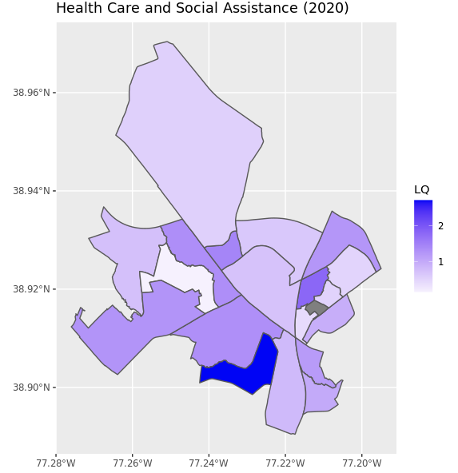
Tysons aera: Professional, Scientific, and Technical Services industry

